Slide 1
South Asian solidarity?
Some Panjabi merchants, British subjects since the annexation of the Panjab the year before, called at the British embassy and got into an argument with Jang on the likely duration of British rule in India. They maintained that ‘India was at sleep at present, but that ere long she would awake.’ Jang replied that India would never be free while Britain remained a leading power in Europe as ‘the English, though few, were men, while Hindustanis were women.’
Reminiscences, p.148
When they saw Indian people and the city of Bombay it felt as if they were back at home with their own families and they were very happy.
Belait-Yatra, p.182
Visited in Benares by an ex-Raja, after a very short time he politely but
firmly told the man he must go, remarking after to Cavenagh, ‘That’s the way to get over an interview with a native’.
Reminiscences. p.175

Slide 2
Reservations about the British
Cavenagh realised that, despite all his public protestations of friendship, he retained considerable mistrust of Britain’s ultimate intentions towards his country. This came out clearly when Jang explained to him, after their return to India, his reason for not wanting to build a road connecting Kathmandu with the plains. He said that he was sure Britain would one day take possession of Nepal and that if such a road were available for use by the invading force then its builder would go down in history as the author of his own country’s destruction. His attitude was illustrated, too, by the parable he used to give his view of the history of Britain’s involvement in India: when man first invented the axe-blade the oak assured his fellow trees that they were in no danger as long as they remained united, but when the ash agreed to form the axe handle, the oak told the others that there was now no hope for them.
Jang Bahadur in Europe, pp. 98-99.

Slide 3
An illusion sustained?
`Calcutta deemed it useful…to sustain the illusion that … their native land was the emerald paradise… that London was a splendid city whose streets, if not actually paved with gold, were nevertheless broad and clean and orderly.’ (Andrew Ward, Our Bones are Scattered, New York 1996, p.46)
`It seemed as if we were in a dream, or as if this were the heaven where virtuous men went after their death…The people of that country do not carry loads themselves. That is done only by ships, trains and carts. The English lead a very happy life. Nobody wears dirty or torn clothes. No one stays dirty: they wash by rubbing themselves down with soap and water and using a brush, and everyone’s face shines like the moon.’ (Belait-Yatra, translated in Jang Bahadur in Europe, p.142 & 146)
‘All the people here appear prosperous and happy, they cannot have encountered sorrow even in their dreams’ (Subedar-major Shersingh Rana, Mero London Rajtilak Yatra, Benares, 1913, p.11)

Slide 4
Police patrol in the London slums c.1870 (by Gustave Doré)

Slide 5
Interior of St. James’s Theatre in the 1830s (Painting by John Gregory Crace, Berger Collection)

Slide 6
Parliamentary Supremacy
Who would be bold enough to speak improperly before such a body? For in front of the
members are set huge books which one might suppose contain all the wisdom of the Satya, Treta,
Dvapar and Kali Yugas, all the knowledge in heaven and earth; thus they are able to tell who is
speaking the truth, while if anyone has done wrong, they are ready to punish him. There can be
no unseemly argument in the assembly. One person speaks and then another replies. If an
argument is accepted, then they all show their agreement by saying ‘yes.’ If an argument does
not completely convince, they discuss it, consider the facts of the case, consult the books and
give their verdict. The Parament council does not tolerate wrongdoing on anyone’s part. They can
even replace the sovereign. If the Prime Minister offends, they can dismiss him. If the
Commander-in-Chief offends, they can replace him. Be the lord, duke, general, colonel or
anything else, a man’s rank is of no account if he does wrong. If a regiment mutinies, then the
Parament council brings up other regiments and blows the mutineers to pieces with cannon. The
law establishing this powerful house of God was drawn up by the old ancestor of the English,
Jesu Christ.
(Jang Bahadur in Europe, p. 156-7)

Slide 7
The sovereign’s revenue
The sovereign cannot confiscate anybody’s property, punish anyone, resort to
violence or insult, nor hand out and cancel appointments at his own pleasure, as if he
were absolute master of his own resources. His wealth in fact comes from the
earnings from agriculture of the nobility, the military and the common people, who
give up one half as the King’s share. They also hand over, in the form of excise duty,
some of the proceeds from trade. If people obtain spoils by raiding an enemy country,
they hand them over as the King’s property. If they mine iron, copper, lead, gold,
silver or precious stones, they set aside a share for the King. If enemies come to
attack the country, then the nobles and soldiers defeat them at the risk of their own
lives and so save the nation. They then assign themselves larger or smaller shares
according to the effort each makes and they contentedly and unanimously agree to
accept this as their wages. When the enemy comes the sovereign himself does not
take the field: he neither kills anyone else, nor is he himself killed. It is the nobles who
have to kill or be killed, which is why the treasury is the common property of them all.
(Jang Bahadur in Europe, p. 152-3)

Slide 8
TRADITIONAL HIERARCHY AS ENSHRINED IN THE 1854 LEGAL CODE (`MULUKI AIN’)
`CORD-WEARERS’
Parbatiya: Brahman, Thakuri, Chetri
Madhesi: Brahman, Rajput, Kayastha
Janajati: Newar Brahmans
`ALCOHOL-DRINKERS’
Janajati: most Newar castes, Tamang, Magar, Gurung, Limbu, Rai, Sherpa, Tharu etc.
`WATER-UNACCEPTABLE ’
One or two Newar castes
Muslims, Europeans
`UNTOUCHABLE’
Parbatiya occupational castes: Kami, Sarki etc.
Madhesi occupational castes
Lowest Newar castes

Slide 9
Maintaining Caste at Sea
‘… an animal with an apparently orthodox tail was duly made over to the Nepalese party for execution. The appointed executioner was not disposed to become too inquisitive as to the origin of the shortness of the tail of the fine fat sheep destined to become the dinner of himself and his fellows. Unfortunately, however, amongst the members of the Minister’s suite was as old Kazi under a vow not to indulge in animal food for a certain period; under no circumstances, therefore, could he partake of the repast. This old gentleman, who was of a rather crabbed disposition, insisted on being allowed to satisfy himself that this brethren acted in accordance with their religious tenets. The result of his minute scrutiny established the fact, a fact I am inclined to believe previously, if not actually known then very shrewdly guessed by all his comrades, that the animal they were about to sacrifice had in fact been born with a long tail, and that the tail had been docked. Outwardly great was the astonishment manifested. Inwardly, I fancy, many were the curses against their friend’s officiousness.’
Reminiscences, p.115-6

Slide 10
…and on a rail journey
`Whilst the train, was stopping at the Castle station, an incident occurred which illustrated a characteristic of the religion of these Oriental visitors. His highness being thirsty the interpreter inquired for some water, and, in the emergency, one of the porters hastily procured it in one of the men’s coffee cans. This not being accepted, and the porter supposing the vessel was too plebeian for his highness to use, a clean tumbler, containing the pure element, was tendered, but also solemnly rejected. In this dilemma his Highness, or Magnificence, as the splendour of his costume would warrant his being styled, caught sight of the stand-pipe and hose by which the engines are supplied with water, and supposing it to be a spring, endeavoured to find where he could dip in his own drinking-cup, and procure water unpolluted by contact with any vessel in Christian use. The whole party curiously examined the water-pipe, but of course could make nothing of it, and returned to the train with his Highness's want unsatisfied.’
From an un-named Lancaster newspaper, quoted in T Smith, Five Years’
Residence at Nepaul, op cit.. Vol. II, pp. 132-3.

Slide 11
Vauxhall Pleasure Gardens (Punch, July 1850)

Slide 12
Jang with Laura Bell, as recently imagined by Hari Prasad Sharma

Slide 13
The dancer Cerito, celebrated recipient of Jang’s generosity in Paris

Slide 14
From Autobiography of Lutfullah – a Muslim visitor in 1844
`Seclusion of women from the society of men is considered a fault by the English, but a virtue by us, the true believers. The English leave their women uncontrolled in life and permit them to enjoy the society of men both in public and in private. Poor creatures! Naturally weak, how many of them fall victim to the brutal intrigues of men! How many families of high name have been ruined by this unreasonable license!’ (p.321)
`Whilst the females whirled round in their dancing, their gowns flew up to the forbidden height. Tantalizing the assembly it appears was their principal aim by such a violation of decorum.’ (pg. 386)
`[Englishmen’s] obedience, trust, and submission to the female sex are far beyond the limit of moderation. In fact, the freedom granted to womankind in this country, and the mischief arising from this unreasonable toleration is most deplorable’ (pg.409)

Slide 15
Dilip Hiro on his experience coming to Britain in the 1950s: Bhikhu Patekh (ed.). Colour, Culture and Consciousness: Immigrant Intellectuals in Britain, London, Alien & Unwin, 1974, p. 20.
‘... .for the first few months, my critical faculties were, to say the least, underdeveloped. All girls appeared beautiful to me. There was an apparent confusion in my mind— something that I shared with most people from the Indian subcontinent— of equating fair skin with beauty. To me, then, being white meant being beautiful. It was only after many exposures to a bevy of young women in dance halls that I began to
distinguish the plain-looking from the merely presentable, and the attractive from the really beautiful....’

Slide 16
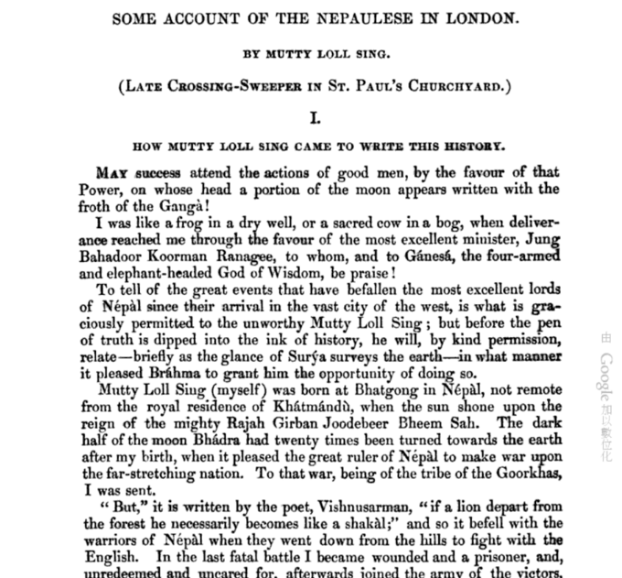

Slide 17
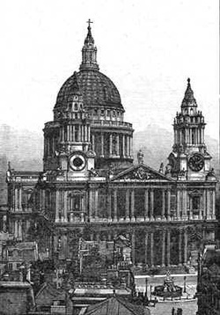
St. Paul’s Cathedral in the mid-19th century

Slide 18
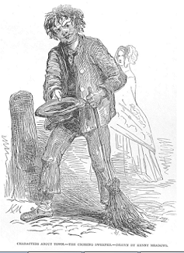
London crossing sweeper (Illustrated London News, 14 June 1848)

Slide 19
Moti Lal – or his editor – analyses the French…
That night we all go to Mitchell’s French Theatre, of St. James’s. On the way
I explain to the excellent minister who are the French, and why they come to
London. “The French,” I say, “are white men – not so white as the English –
with black beards, rolling eyes, and speaking through their noses, or with a
sound in their throats like the gurgling of water as it runs into a tank. They
are a people who do not like sitting quiet on the carpet of happiness; a thorny
seat is their delight. To fight with everybody is their great pleasure; but, most
of all, they like to fight with themselves. Like the monkeys of the forest of
Dandaca, they are always chattering; never at work but in mischief; like
monkeys, too, they imitate all they see, and are the best play actors (Natas)
in the world. The English people are fond of plays, but unable to act them,
oblige Mitchell to invite the French with money. Gladly they come, for none is
to be had in their own country. To this I add, that their food is the flesh of
reptiles.”

Slide 20
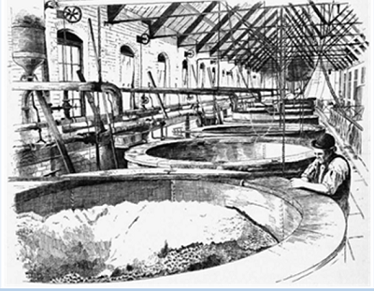
`The vats that hold the porter are of such enormous dimensions that a thousand persons might swim in one with ease, and men are drowned in them daily by scores. This is thought nothing of here, except by these accidents the porter is said to be improved in flavor.’ (Moti Lal’s description of Barclay & Perkins’ brewery

Slide 21
Did Moti Lal go home?
He reached Paris with Jang’s party: : “The Nepaulese Ambassador (who has just left us for Paris, which is so crowded that RUM JUGGUR could hardly find a bed, and SHREE Mutty- ce chère MUTTY, as the French call him – was compelled to sleep in a cookloft)…”. (Punch, vol.XIX , no. 478,1850, pg. 101)
Does he have descendants in Nepal or Calcutta?

Slide 22
Mohammed Ali Khan speaks on his the night before his execution, as recalled by William Forbes-Mitchell in Reminiscences of the Great Mutiny.
Th
the way I explain to the excellent minister who are the French, and why they
come to London.
“Th e French,” I say, “are white men – not so white as the English – with
black beards, rolling eyes, and speaking through their noses, or with a
sound in their throats like the gurgling of water as it runs into a tank. They
are a people who do not like sitting quiet on the carpet of happiness; a
thorny seat is their delight. To fight with everybody is their great pleasure;
but, most of all, they like to fi ght with themselves. Like the monkeys of the
forest of Dandaca,5they are always chattering; never at work but in
mischief; like monkeys, too, they imitate all they see, and are the best playactors
(Natas) in the world. Th e English people are fond of plays, but unable
to act them, oblige Mitchell to invite the French with money. Gladly they
come, for none is to be had in their own country. To this I add, that their
food is the flesh of reptiles.”
. I had not joined the Company's service from any desire for wealth, but from the hope of gaining honourable service; yet on the very threshold of that service I met with nothing but disgrace and dishonour, having to serve under a man whom I hated, yea, worse than hated, whom I despised. I wrote to my father, and requested his permission to resign, and he agreed with me that I the descendant of princes, could not serve the Company under conditions such as I have described. I resigned the service and returned home, intending to offer my services to his late Majesty Nussir-ood-Deen, King of Oude; but just when I reached Lucknow I was informed that his Highness Jung Bahadoor of Nepal, who is now at Goruckpore with an army of Goorkhas coming to assist in the loot of Lucknow, was about to visit England, and required a secretary well acquainted with the English language. I at once applied for the post, and being well backed by recommendations both from native princes and English officials, I secured the appointment, and in the suite of the Maharaja I landed in England for the first time, and, among other places, we visited Edinburgh, where your regiment, the Ninety-Third Highlanders, formed the guard of honour for the reception of his Highness. Little did I think when I saw a kilted regiment for the first time, that I should ever be a prisoner in their tents in the plains of Hindustan; but who can predict or avoid his fate?

Slide 23
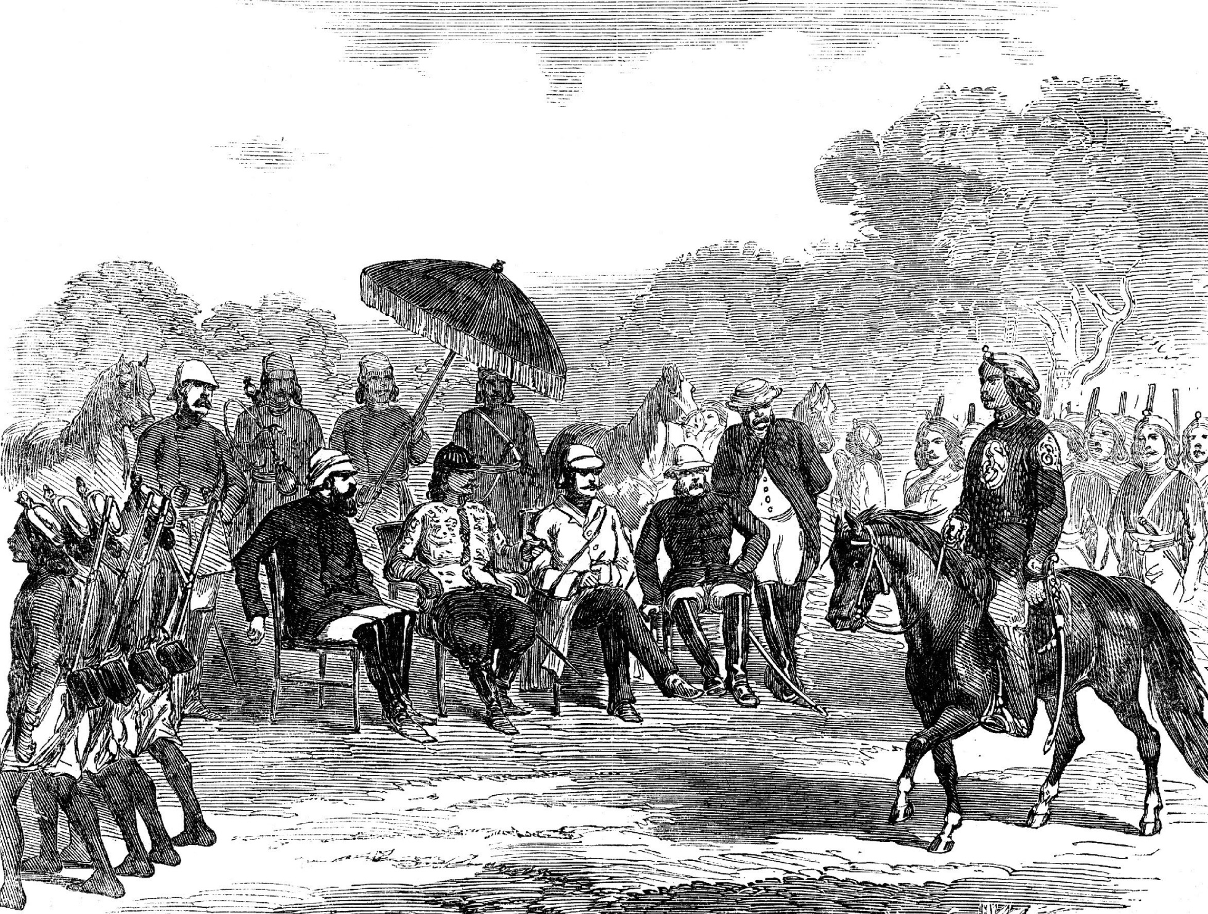
Nepalese troops parading before Jang Bahadur and British officers at Lucknow, 1858
Picture of Lucknow

